Slide 1
Creating Apps With .NET MAUI for iOS, Android, macOS + Windows
Brandon Minnick
Code Traveler, LLC

Slide 2
.NET MAUI The Evolution of Xamarin.Forms

Slide 3
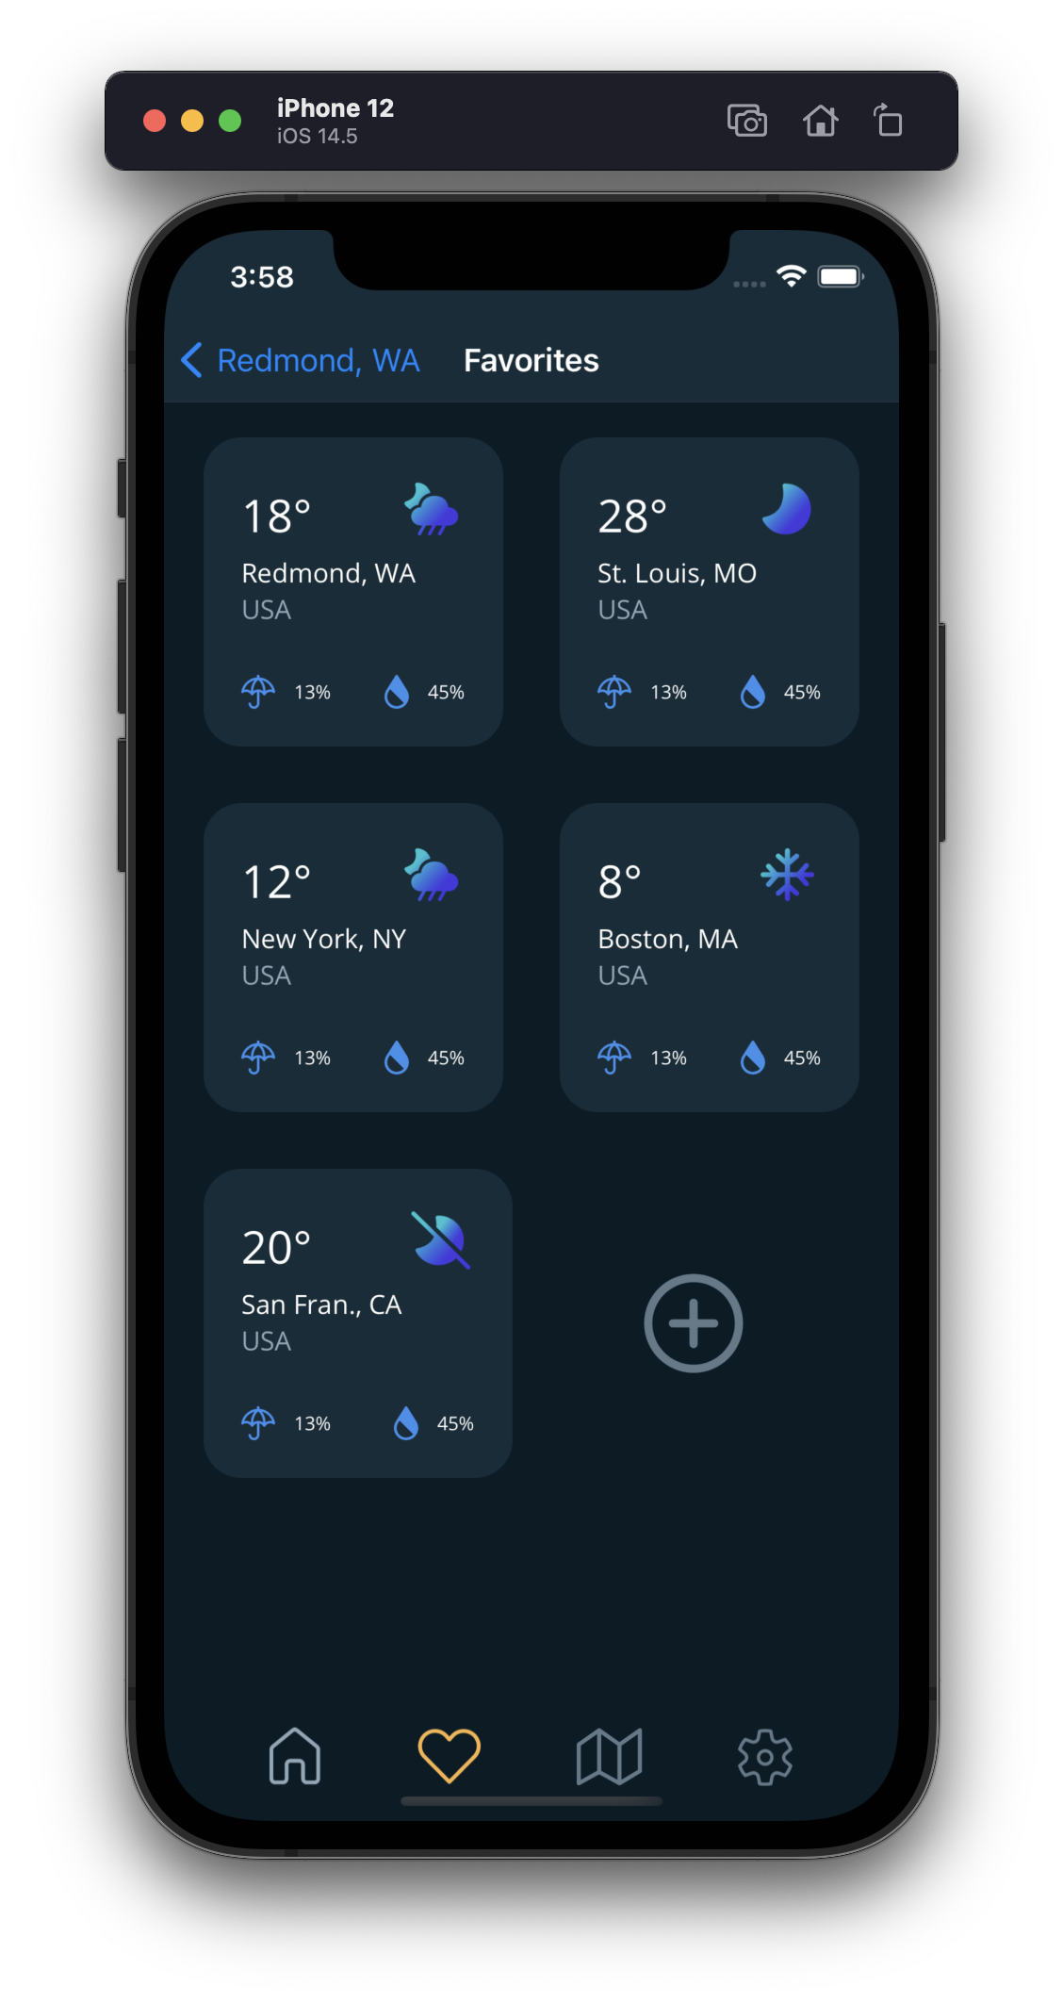
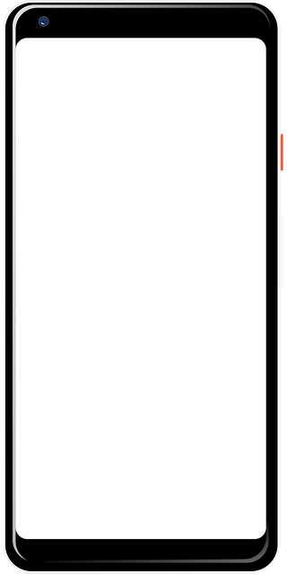
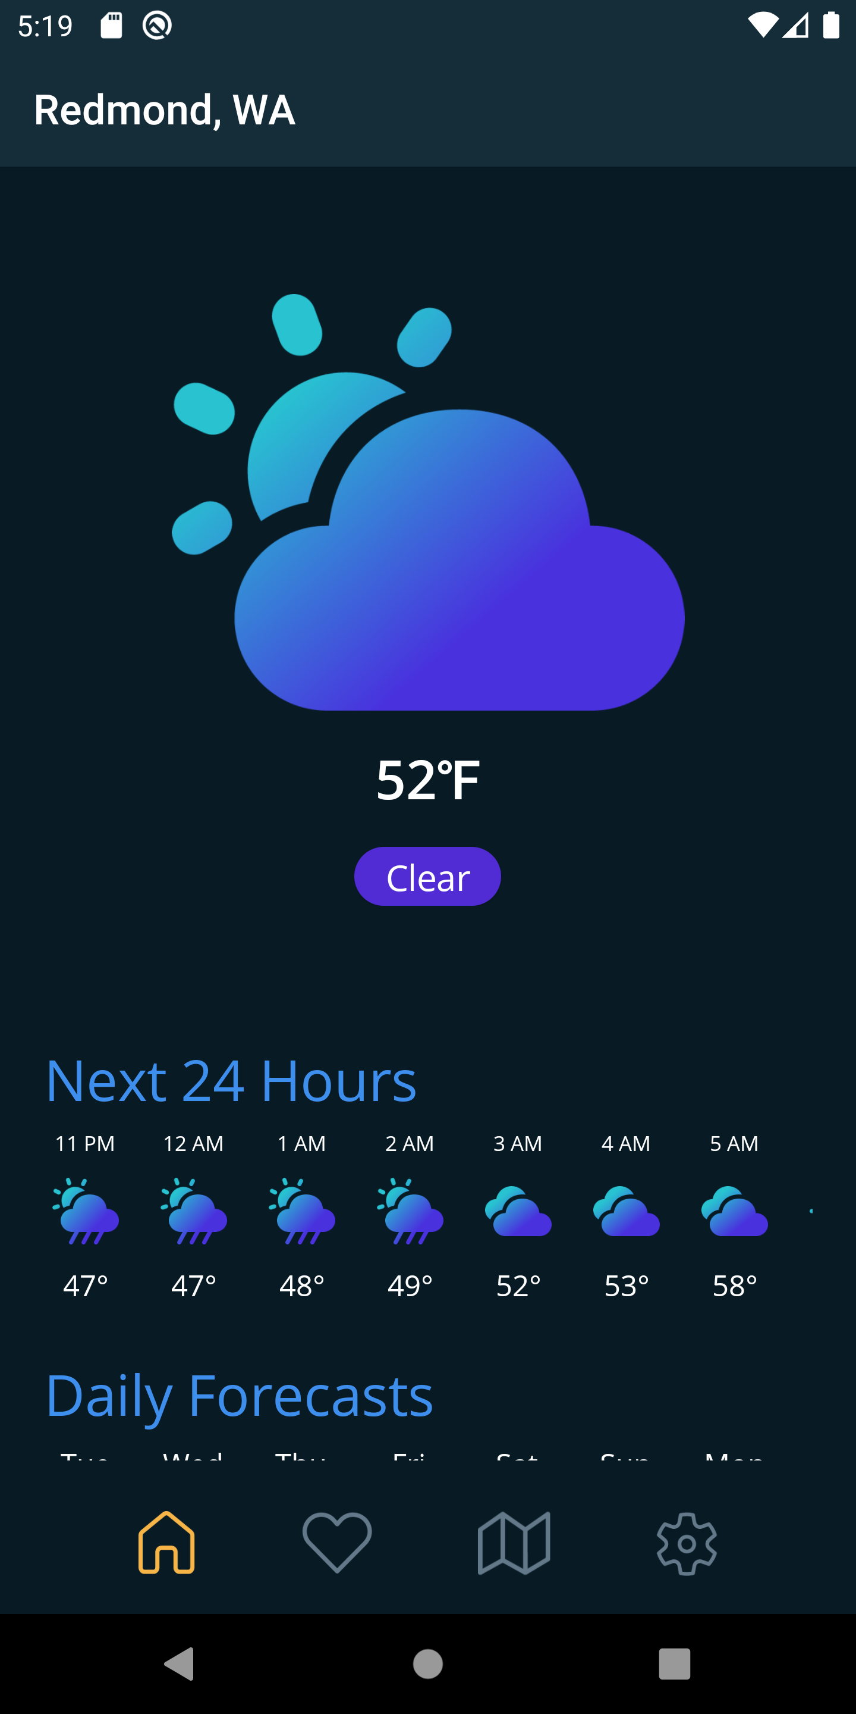
.NET MAUI Cross-Platform UI Framework

Slide 4
Everything you can do
in Objective-C, Swift, Java or Kotlin
can be done in C# with .NET MAUI

Slide 5
.NET MAUI Architecture
UI Framework
.NET MAUI Controls (MVVM)
.NET MAUI BlazorWebView
Comet
(MVU)
????
Interface
.NET MAUI Core
Platform
iOS
Android
Windows
macOS
Tizen
???

Slide 6
.NET MAUI Deep Dive

Slide 7
Creating a .NET MAUI App

Slide 8
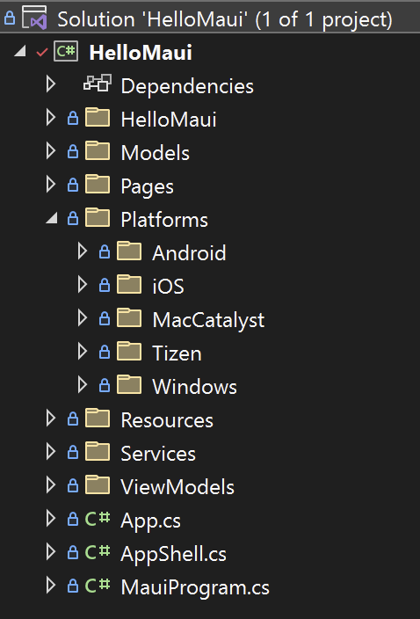
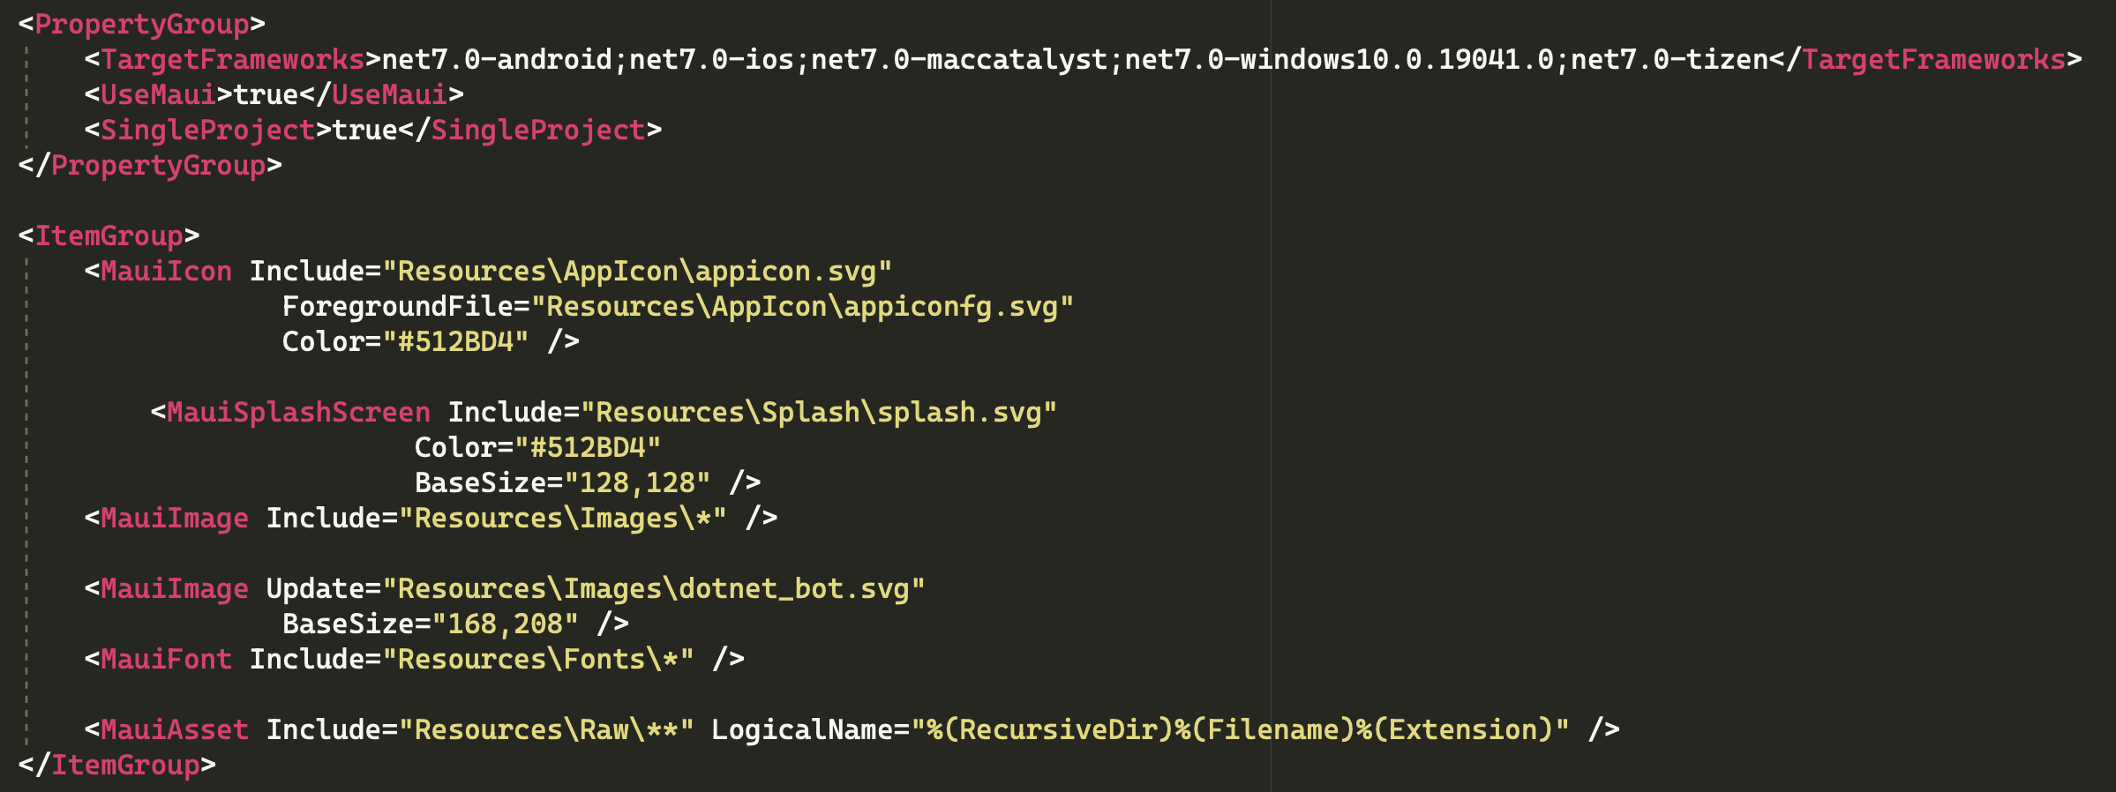
.NET MAUI Single Multi-Targeted Project

Slide 9
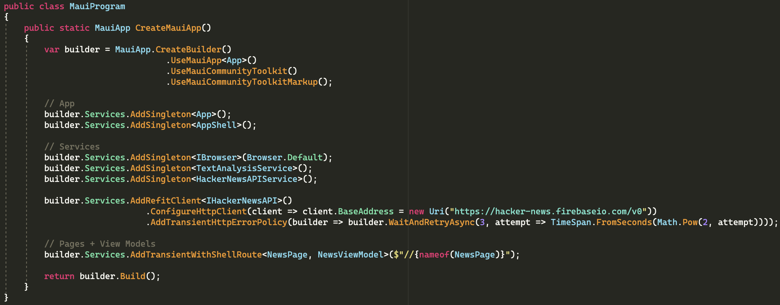
.NET MAUI MauiProgram.cs
https://github.com/brminnick/HackerNews

